Slide 1
Plants Around the World
Gallery Walk
Grade 1 Unit: Project 1

Slide 2
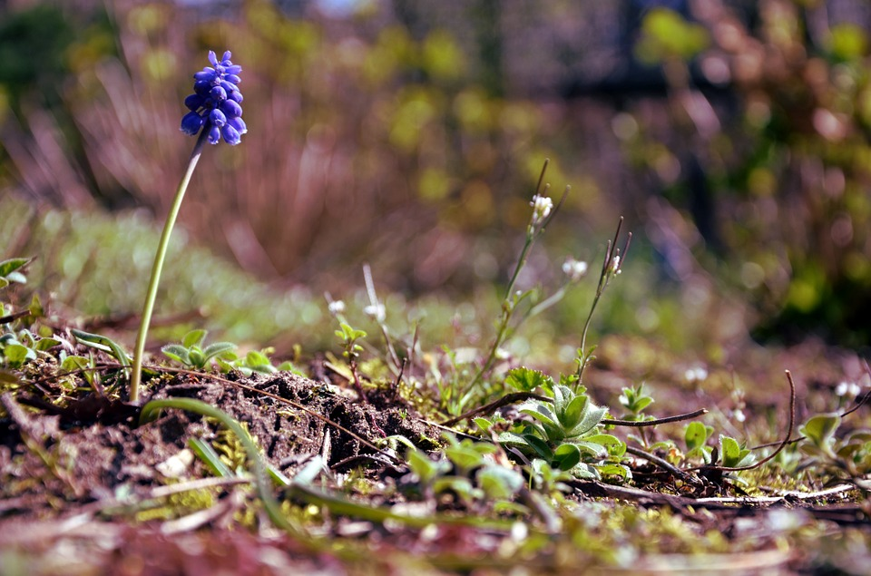

Slide 3
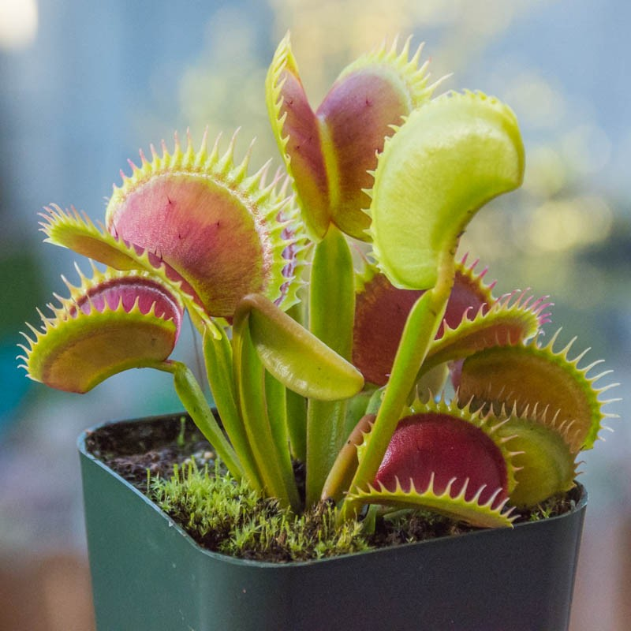
Venus Fly Trap

Slide 4
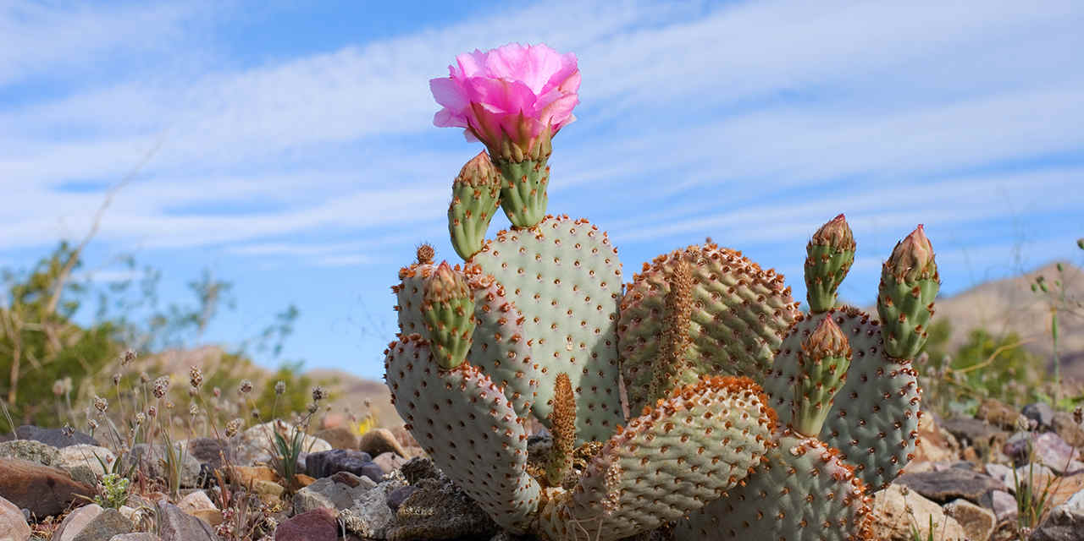
Notes:
California Cactus

Slide 5
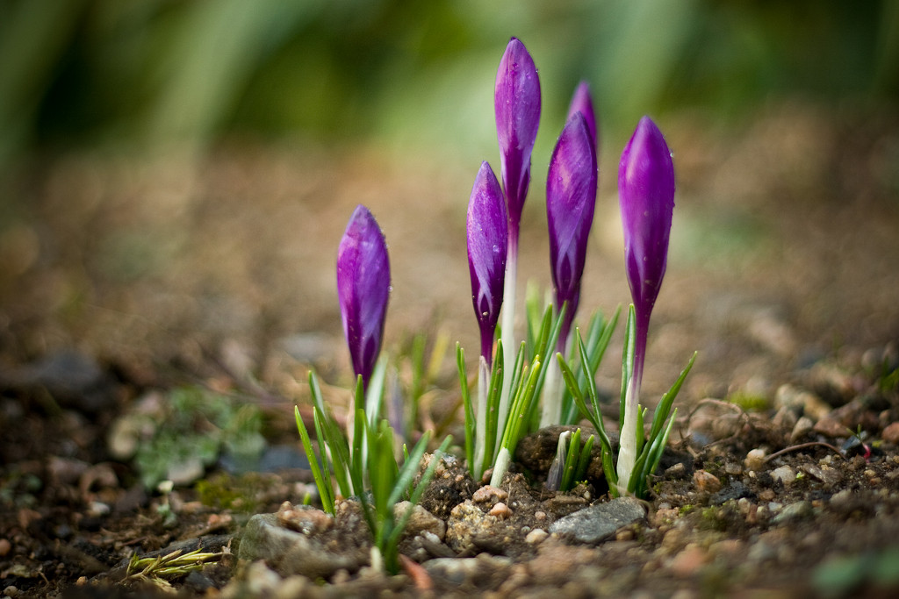

Slide 6
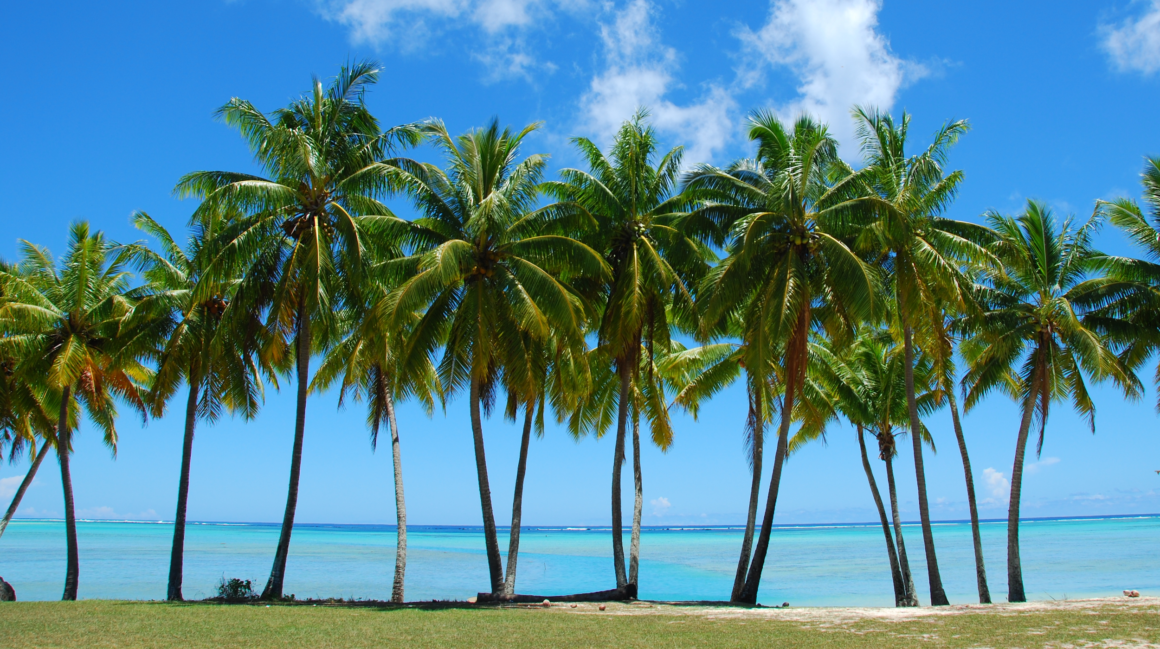

Slide 7
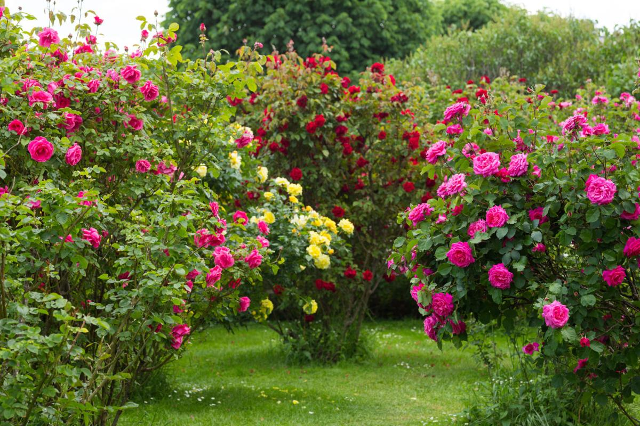

Slide 8
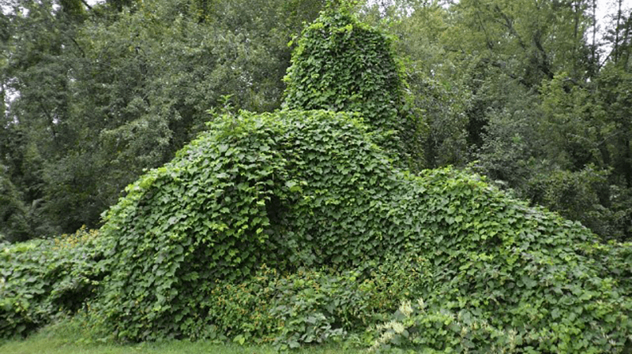
Notes:
Ivy

Slide 9
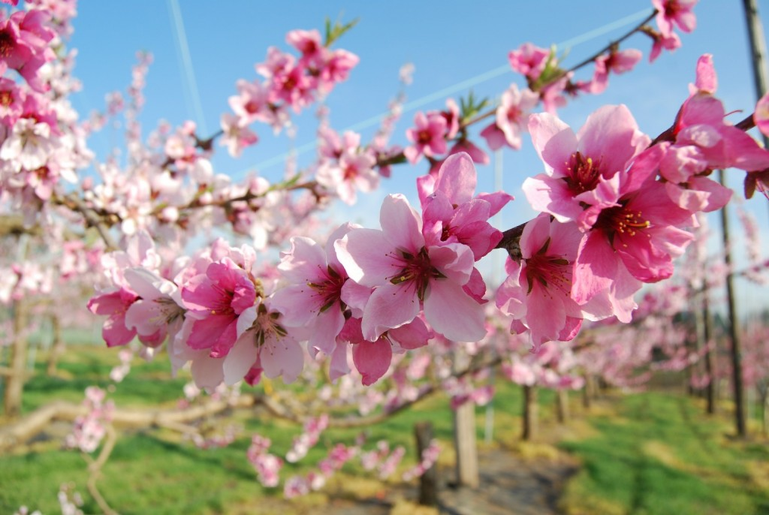
Notes:
Japanese flowers

Slide 10
