Slide 1
O'Keeffe- Inspired
Flower/ Plant Paintings
Gallery Walk: First Grade Unit Project 3

Slide 2
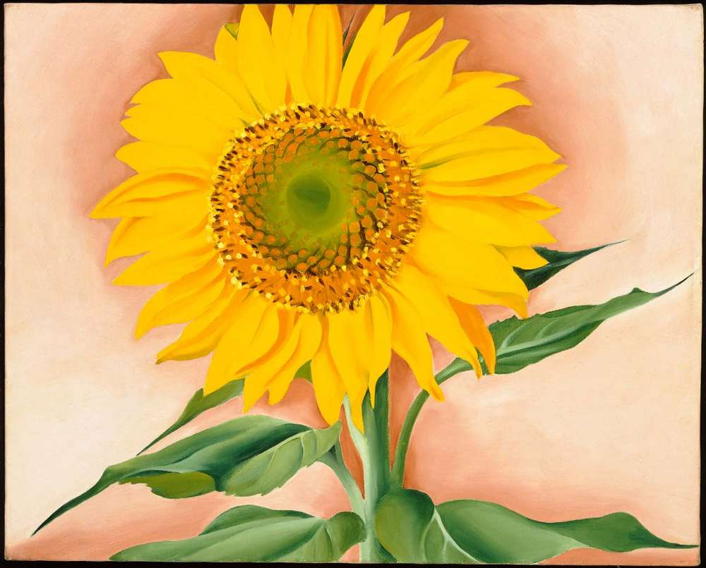

Slide 3
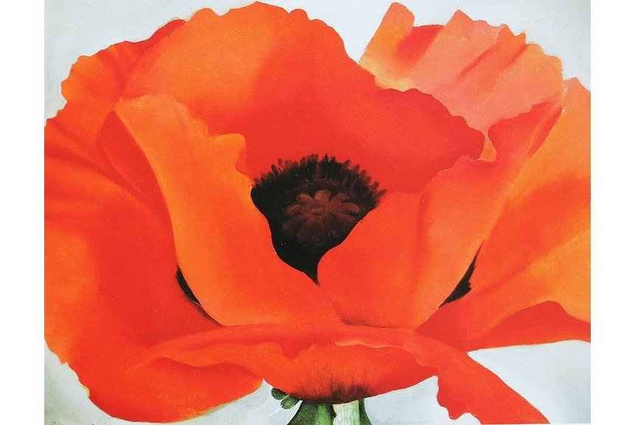

Slide 4
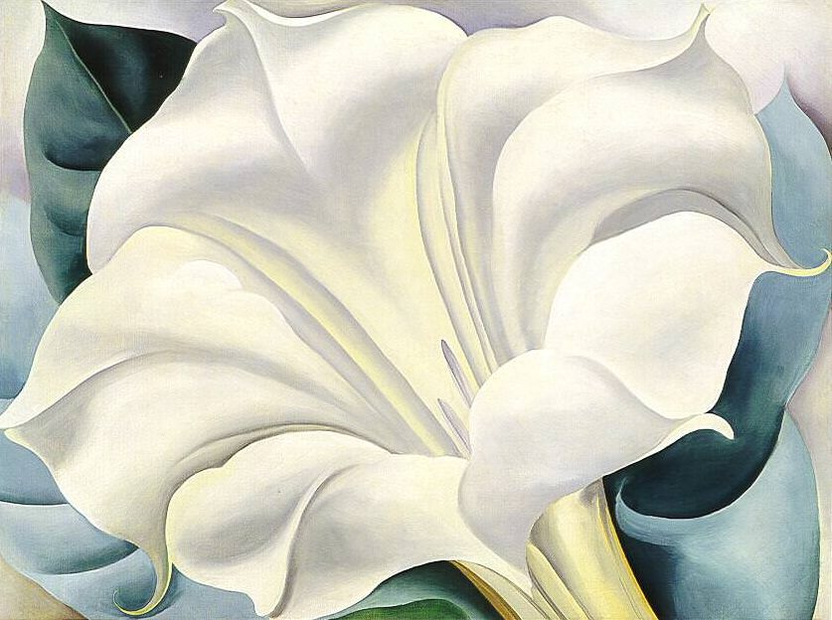

Slide 5
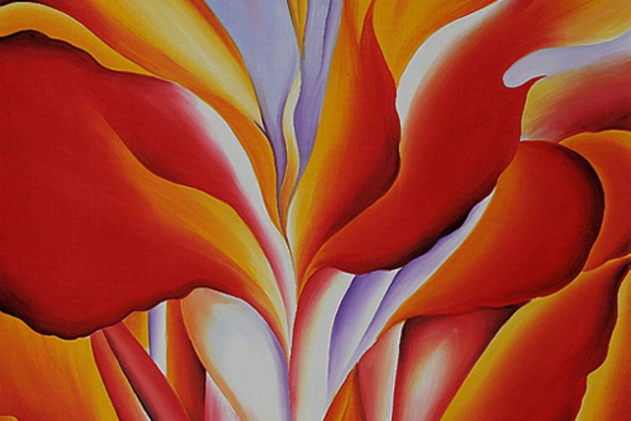

Slide 6
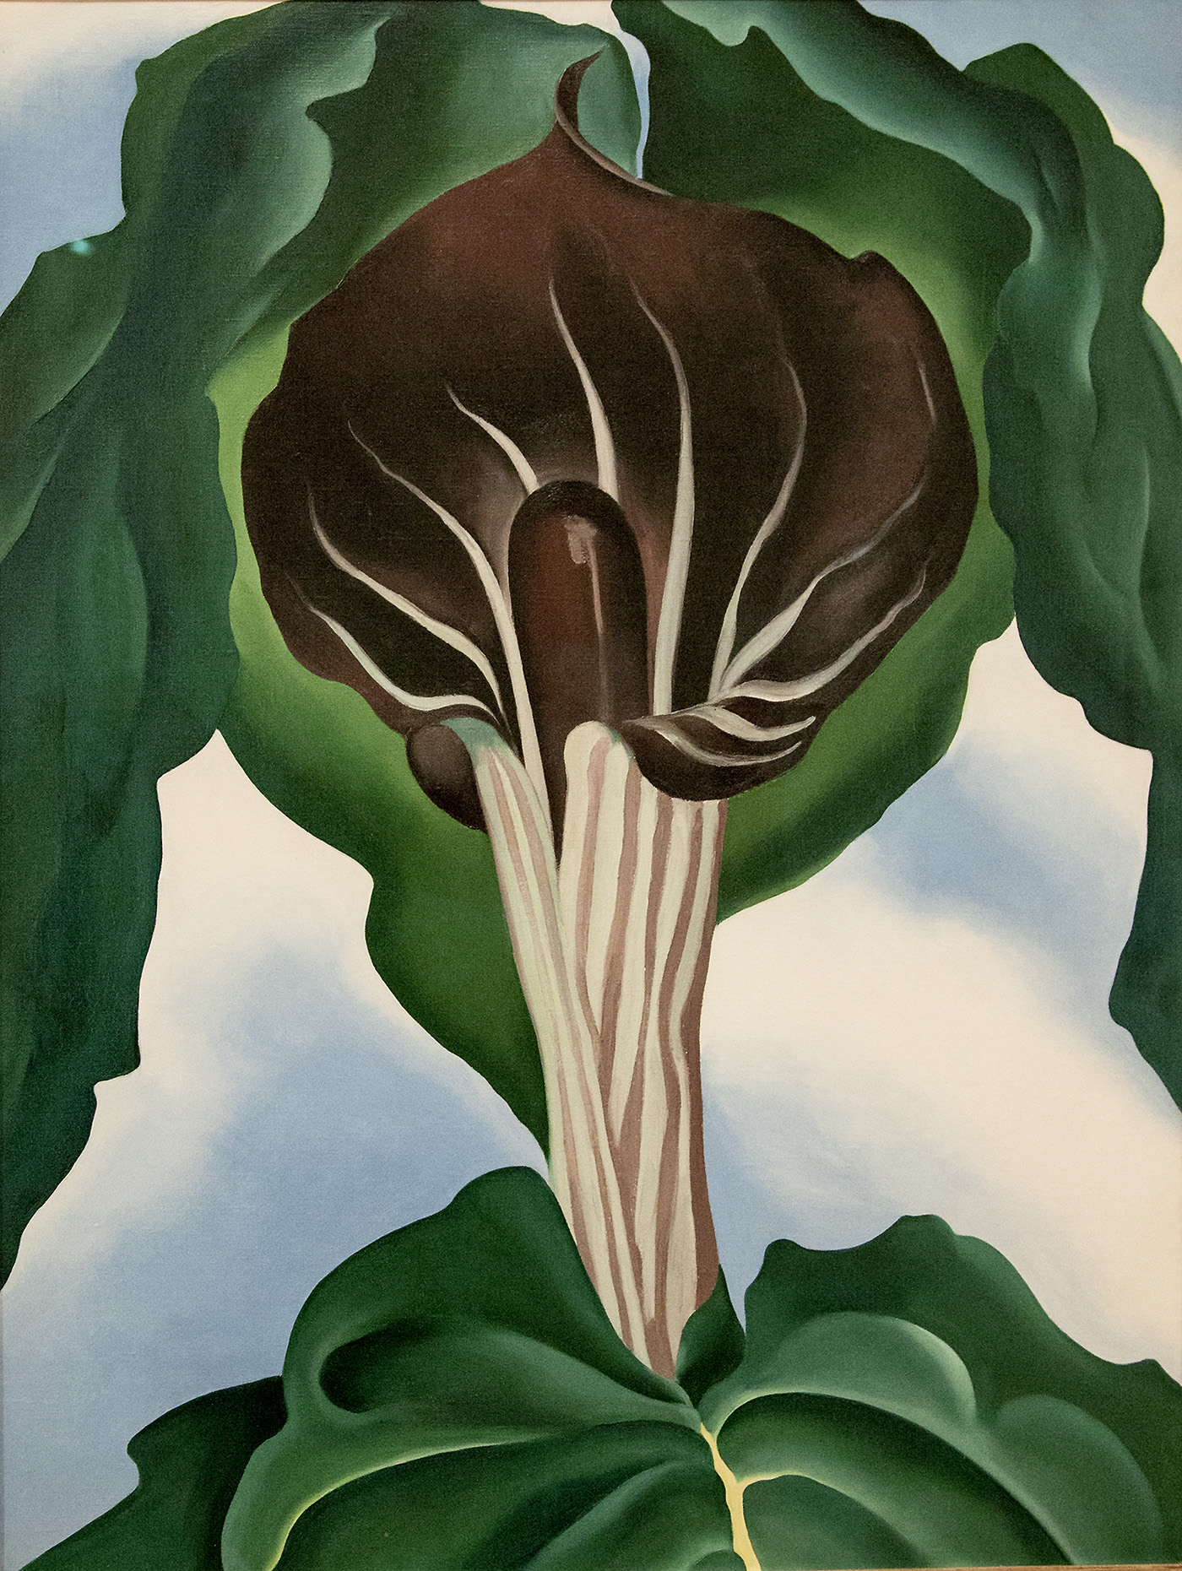

Slide 7
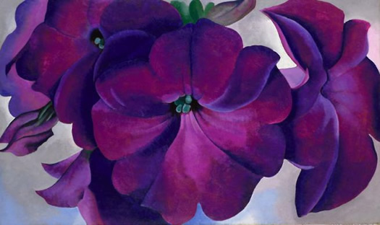

Slide 8
